Slide 1

Analysis of Education and Socioeconomic Status
By: Mubashira Qari
This Photo by Unknown Author is licensed under CC BY-NC

Slide 2
motivation for performing this analysis
Source of motivation for the final project is the article about:
Education and Socioeconomic Status
https://www.apa.org/pi/ses/resources/publications/education

Slide 3
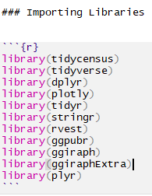
Goal of the Project:
To evaluate the impact of
per capita income on educational attainment.
Notes:
Using ggPredict() - Visualize Regression Model
We can show this model with ggPredict() function and adjust the number of regression lines with parameter colorn.

Slide 4
STEPS to achieve the Goal
Collect the required data.
Perform the exploratory data analysis (EDA).
Perform extract load and transform (ETL) process.
Design a relational database to import in PostgreSQL.
Apply a linear regression model.
Estimate the correlation between per capita income and the bachelor's degree attainment.
Interpretation of the results.

Slide 5
Data Sources:
Web Scraping is performed to fetch fips code for all US counties:
https://en.wikipedia.org/wiki/List_of_United_States_FIPS_codes_by_county
API call to fetch Census data for all US counties:
https://api.census.gov/data/2019/acs/acs1?get=NAME,B01001_001E&for=county:*
A CSV file is downloaded from 'Economic Research Service’ U.S. DEPARTMENT OF AGRICULTURE:
https://www.ers.usda.gov/data-products/county-level-data-sets/download-data/
Notes:
When performing the web scraping from Wikipedia, the html source code is generated by calling the read_html function.
I used html_nodes function using CSS Selector and a table is generated using html_table function.
Next, I access the Census API key, save it in the environmental variable and fetched the Census Data for the year 2020.
And lastly, after downloading the csv file from the USDA, I imported the raw data into the Rmd file from Github.

Slide 6
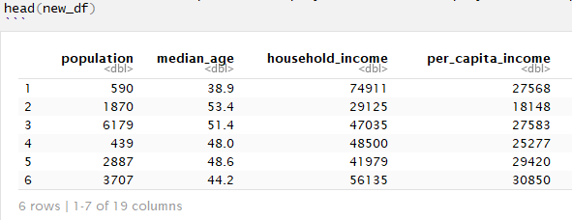
Data Cleaning Steps:
The three dataframes ready for cleaning are: fips_df, census_df, and education_df.
Removing strings like 'county’.
Convert column names to lowercase.
Dropping the null rows.
Renaming the columns.
Converting CHAR to NUM.
Split the name into two county and state columns.
Selecting the column of interest.
Exporting file as csv to working directory for creating a relational database using Quick DBD tool.
Finally, merging the three dataframes on fips code in new_df.

Slide 7
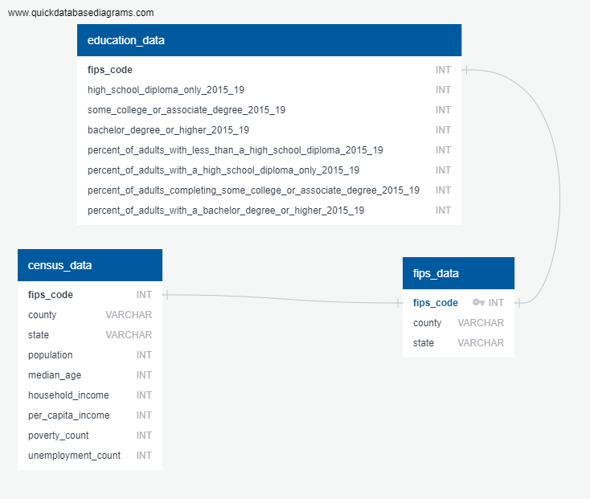

Relational database Design:

Slide 8
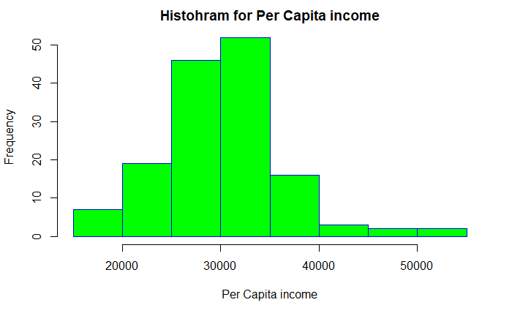
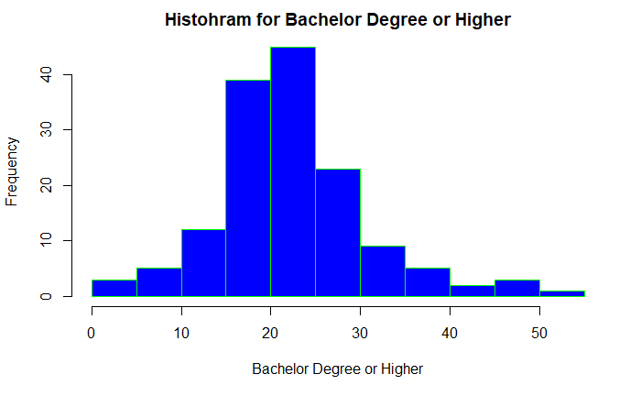
Assumptions for performing the linear regression:
Independence of observations (aka no autocorrelation).
Normality.
Linearity.
Homoscedasticity (aka homogeneity of variance)
Notes:
Before applying the linear regression model, the following four assumption must be made. And it is important to visualize the data based on these assumption.
Since there is only one independent variable and one dependent variable, we don’t need to test for any hidden relationships among variables.
The normality can be checked by using the hist() function, which tells whether the dependent variable follows a normal distribution or not.
The histograms show that our data follows the normal distribution.
The relationship between the independent and dependent variable must be linear. We can test this visually with a scatter plot to see if the distribution of data points could be described with a straight line.

Slide 9
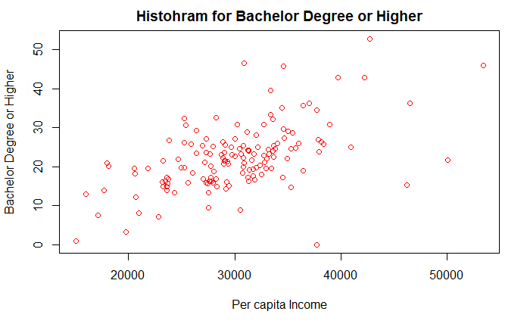
scatter plot for Assumption test
Notes:
This scatter plot is showing a linear relationship between x and y variables.

Slide 10
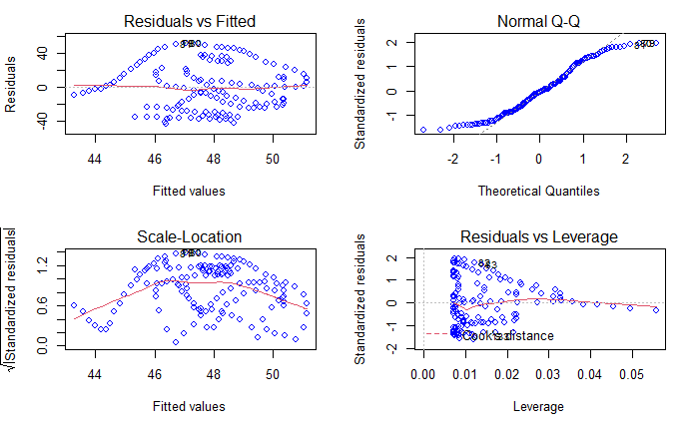
Homoscedasticity (aka homogeneity of variance)
Notes:
The red lines representing the mean of the residuals are all basically horizontal and centered around zero. This means there are no outliers or biases in the data that would make a linear regression invalid.
In the Normal Q-Qplot in the top right, we can see that the real residuals from our model form an almost perfectly one-to-one line with the theoretical residuals from a perfect model.
Based on these residuals, we can say that our model meets the assumption of homoscedasticity.
and the appropriate visualizations helps us better understand the data.

Slide 11
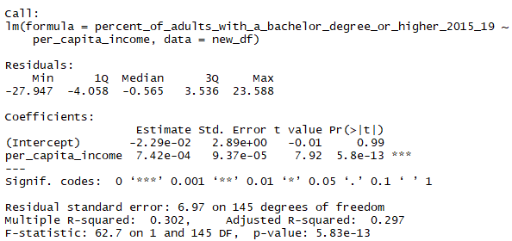
Simple Linear Regression Model & Summary:
Simple Linear Regression Equation:
percent_of_adults_with_a_bachelor_degree_or_higher_2015_19 =
b0 + b4*per_capita_income
The F-Test of overall significance has the following two hypotheses:
Null hypothesis (H0) : The model with no predictor variables (also known as an intercept-only model) fits the data as well as the regression model defined here.
Alternative hypothesis (HA) : Your regression model fits the data better than the intercept-only model.
Notes:
Interpretation:
A large F-statistic will correspond to a statistically significant p-value (p < 0.05). In our example, the F-statistic equal 62.7 producing a p-value: 5.83e-13, which is highly significant. This means that, the predictor variables is significantly related to the outcome variable.
And we accept the alternate hypothesis that our regression model fits the data better than the intercept-only model.
For a given predictor, the t-statistic evaluates whether there is significant association between the predictor and the outcome variable, that is whether the beta coefficient of the predictor is significantly different from zero.
we can see, changing the per_capita_income variable is significantly associated to changes in percent_of_adults_with_a_bachelor_degree_or_higher_2015_19
For a given predictor variable, the coefficient (b) can be interpreted as the average effect on y of a one unit increase in predictor, holding all other predictors fixed.
One unit increase in per_capita_income will significantly increase percent_of_adults_with_a_bachelor_degree_or_higher_2015_19, holding all other predictors fixed.

Slide 12
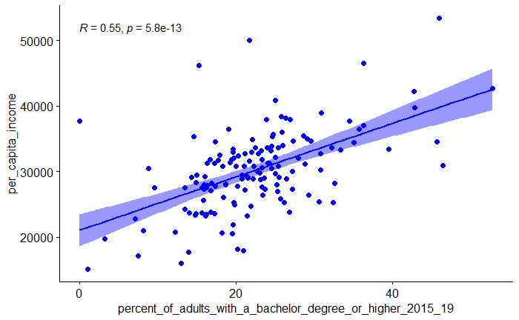
The correlation coefficient between the two variables
Notes:
r is always a number between -1 and 1. r > 0 indicates a positive association. r < 0 indicates a negative association. Values of r near 0 indicate a very weak linear relationship.

Slide 13
Challenges encountered in code and/or data:
Web scraping the SAT score was the biggest challenge.
https://www.nj.com/education/2019/05/see-the-sat-scores-for-every-nj-public-high-school.html
Merging three data frames was not easily achievable.
Notes:
Found out that it is not a user-friendly scrapable site. So, switch to 'Economic Research Service’ U.S. DEPARTMENT OF AGRICULTURE site for education data and performed the we scraping on Wikipedia page for fips code.
Merging three data frames was not easily achievable until common column was thoroughly cleaned.

